Slide 1
Development and proof of an Explicit Formula

Slide 2
An Explicit formula for a problem allows direct computation of the answer from an input value.
A Recursive formula requires computing answers to previous cases to find the answer to the desired case.

Slide 3
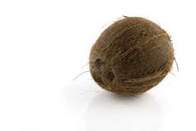
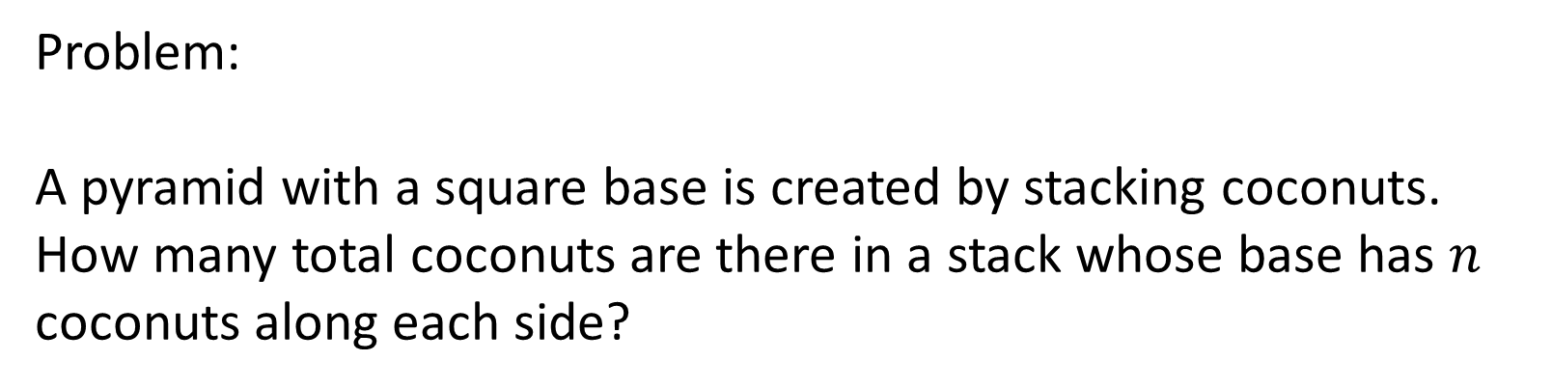
Problem:
A pyramid with a square base is created by stacking coconuts. How many total coconuts are there in a stack whose base has $n$ coconuts along each side?

Slide 4
When developing a new formula to solve a problem, the first thing you want to do is to make sure you have understood the question.
Even when you believe you can visualize this in your mind, drawing pictures or making illustrations will help document the solution.

Slide 5

If visualization or drawing is difficult,

Slide 6
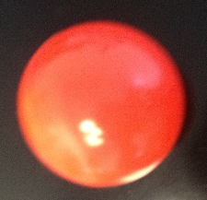
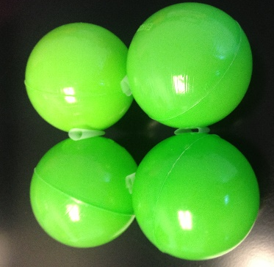
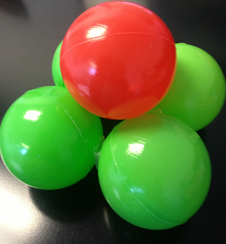
…building a physical model can help.

Slide 7
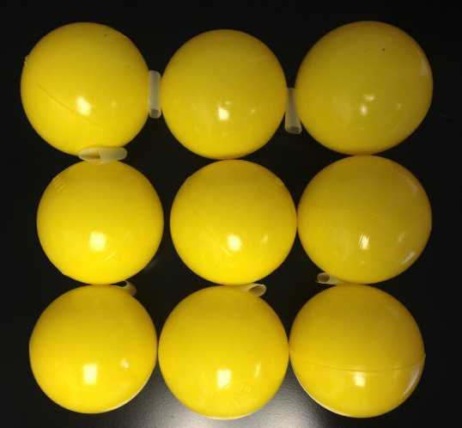
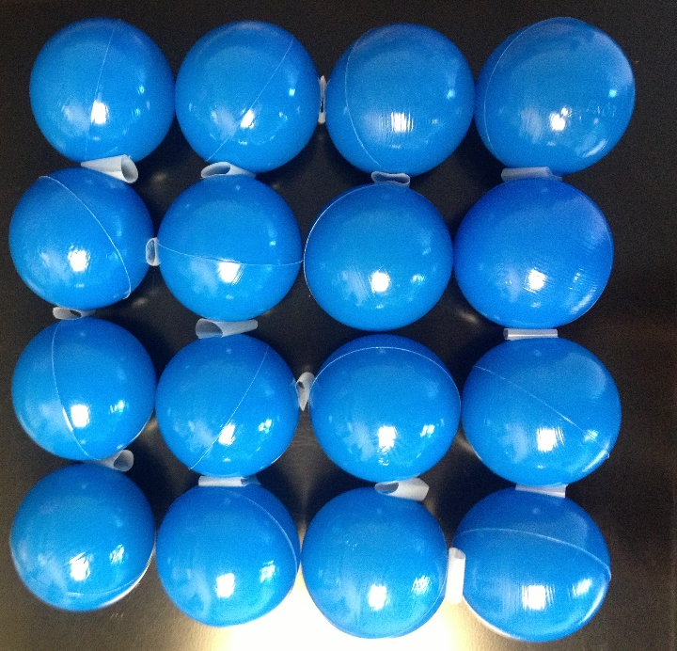
…building a physical model can help.

Slide 8
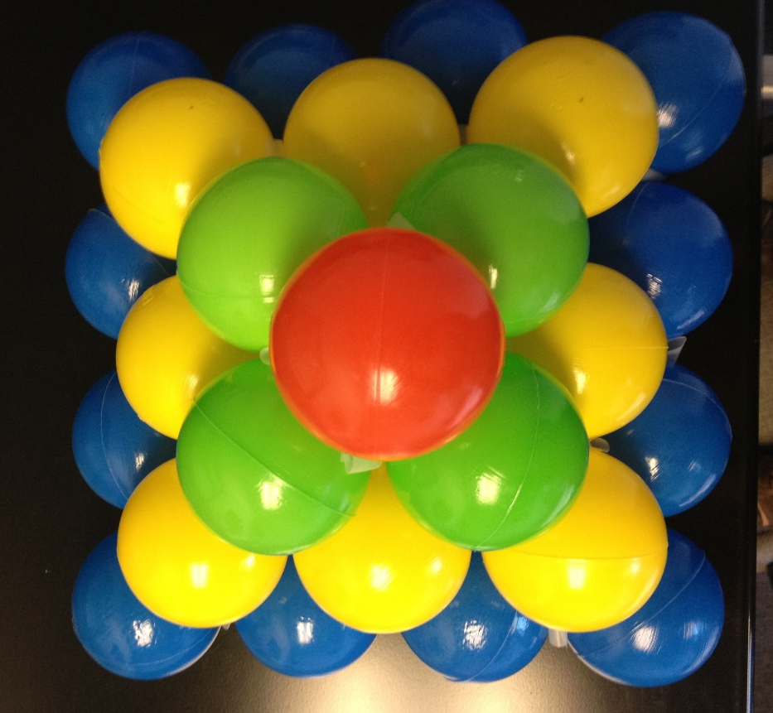
…building a physical model can help.

Slide 9





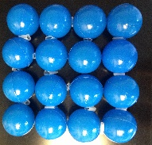
When you are spark thinking, your work may be disorganized. Eventually, you will want to organize your results in a coherent way.
 | Length of side at the bottom of the pyramid | Number of objects in bottom layer | Total number of objects
 | 1 | 1 | 1
 | 2 | 4 | 5
 | 3 | 9 | 14
 | 4 | 16 | 30

Slide 10
Check and double check these first few values. Mistakes early on can make it difficult if not impossible to use the data to find the correct closed form formula.
Length of side at the bottom of the pyramid | Number of objects in bottom layer | Total number of objects
1 | 1 | 1
2 | 4 | 5
3 | 9 | 14
4 | 16 | 30

Slide 11
At this point you may be able to observe a recursive formula. That is, you may be able to find a way to generate more data using the observations you already have.
Length of side at the bottom of the pyramid | Number of objects in bottom layer | Total number of objects
1 | 1 | 1
2 | 4 | 5
3 | 9 | 14
4 | 16 | 30

Slide 12
You may notice that the number of objects in the bottom layer is a perfect square. So you can easily generate values for this column.
Length of side at the bottom of the pyramid | Number of objects in bottom layer | Total number of objects
1 | 1 | 1
2 | 4 | 5
3 | 9 | 14
4 | 16 | 30
5 | 25
6 | 36
7 | 49
8 | 64

Slide 13
You may also notice that the total number of objects is the sum of the previous pyramid plus the number in the new bottom layer.
Length of side at the bottom of the pyramid | Number of objects in bottom layer | Total number of objects
1 | 1 | 1
2 | 4 | 5
3 | 9 | 14
4 | 16 | 30
5 | 25 | 30+25=55
6 | 36
7 | 49
8 | 64

Slide 14
Finding a recursive formula helps to generate new values without a physical model. Recursive computations are risky because errors propagate to all subsequent answers. So be careful!!!
Length of side at the bottom of the pyramid | Number of objects in bottom layer | Total number of objects
1 | 1 | 1
2 | 4 | 5
3 | 9 | 14
4 | 16 | 30
5 | 25 | 55
6 | 36 | 91
7 | 49 | 140
8 | 64 | 204

Slide 15
The ultimate goal is to find an explicit formula that takes the length of the side at the bottom of the pyramid as the input and gives the total number of objects as the output.
Length of side at the bottom of the pyramid | Total number of objects
1 | 1
2 | 5
3 | 14
4 | 30
5 | 55
6 | 91
7 | 140
8 | 204

Slide 16
I am going to rename the first column and just call it the index. That is a traditional name for input that takes on natural number values.
Index | Total number of objects
1 | 1
2 | 5
3 | 14
4 | 30
5 | 55
6 | 91
7 | 140
8 | 204

Slide 17
The goal is a computation that would take an index value and produce the corresponding output value.
3
Index | Total number of objects
1 | 1
2 | 5
3 | 14
4 | 30
5 | 55
6 | 91
7 | 140
8 | 204
14

Slide 18
The computation would of course have to work for all values that have been observed so far.
4
Index | Total number of objects
1 | 1
2 | 5
3 | 14
4 | 30
5 | 55
6 | 91
7 | 140
8 | 204
30

Slide 19
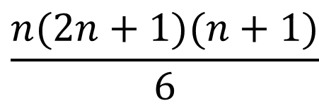
Sometimes you can just examine the input/output table and figure out what the explicit formula should be. This is something mathematicians like to puzzle about. It is fun to figure them out.
4
Index | Total number of objects
1 | 1
2 | 5
3 | 14
4 | 30
5 | 55
6 | 91
7 | 140
8 | 204
$$\frac{n(2n+1)(n+1)}{6}$$
30

Slide 20
The formula should be tested against the available observations to see if it works.
Index |  | Total number of objects
1 | 1(2*1+1)(1+1)/6 | 1
2 | 2(2*2+1)(2+1)/6 | 5
3 | 3(2*3+1)(3+1)/6 | 14
4 | 4(2*4+1)(4+1)/6 | 30
5 | 5(2*5+1)(5+1)/6 | 55
6 | 6(2*6+1)(6+1)/6 | 91
7 | 7(2*7+1)(7+1)/6 | 140
8 | 8(2*8+1)(8+1)/6 | 204

Slide 21
Once you have evidence that the explicit formula works, it is time to attempt a mathematical proof of correctness for all possible values of the index. That means, we want to know for sure that it will work for every natural number .
Below are some natural numbers
1,2,3,4,5, …,k-1, k, k+1, …, n-1 , n, n+1,…
Don’t get confused thinking that k is smaller than n. It is just the way I presented them this time. They are common representations of an integer with its previous and subsequent natural number.

Slide 22
Proof using the principle of mathematical induction.
Mathematical induction can be considered an axiom of the natural numbers. That means, the idea of why it should work are so clear as to be self evident. We don’t have to prove that mathematical induction works.

Slide 23
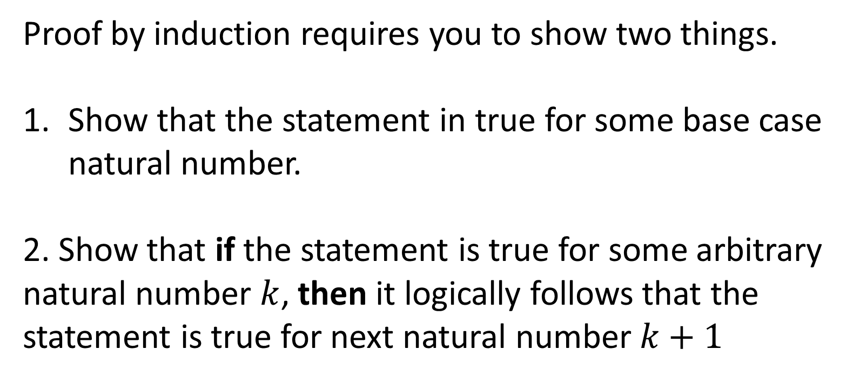
Proof by induction requires you to show two things.
Show that the statement in true for some base case natural number.
2. Show that if the statement is true for some arbitrary natural number $k$, then it logically follows that the statement is true for next natural number $k+1$

Slide 24
The base case is usually the easier part to show.
Most of the work comes in telling the story about why the if-then implication is true.

Slide 25
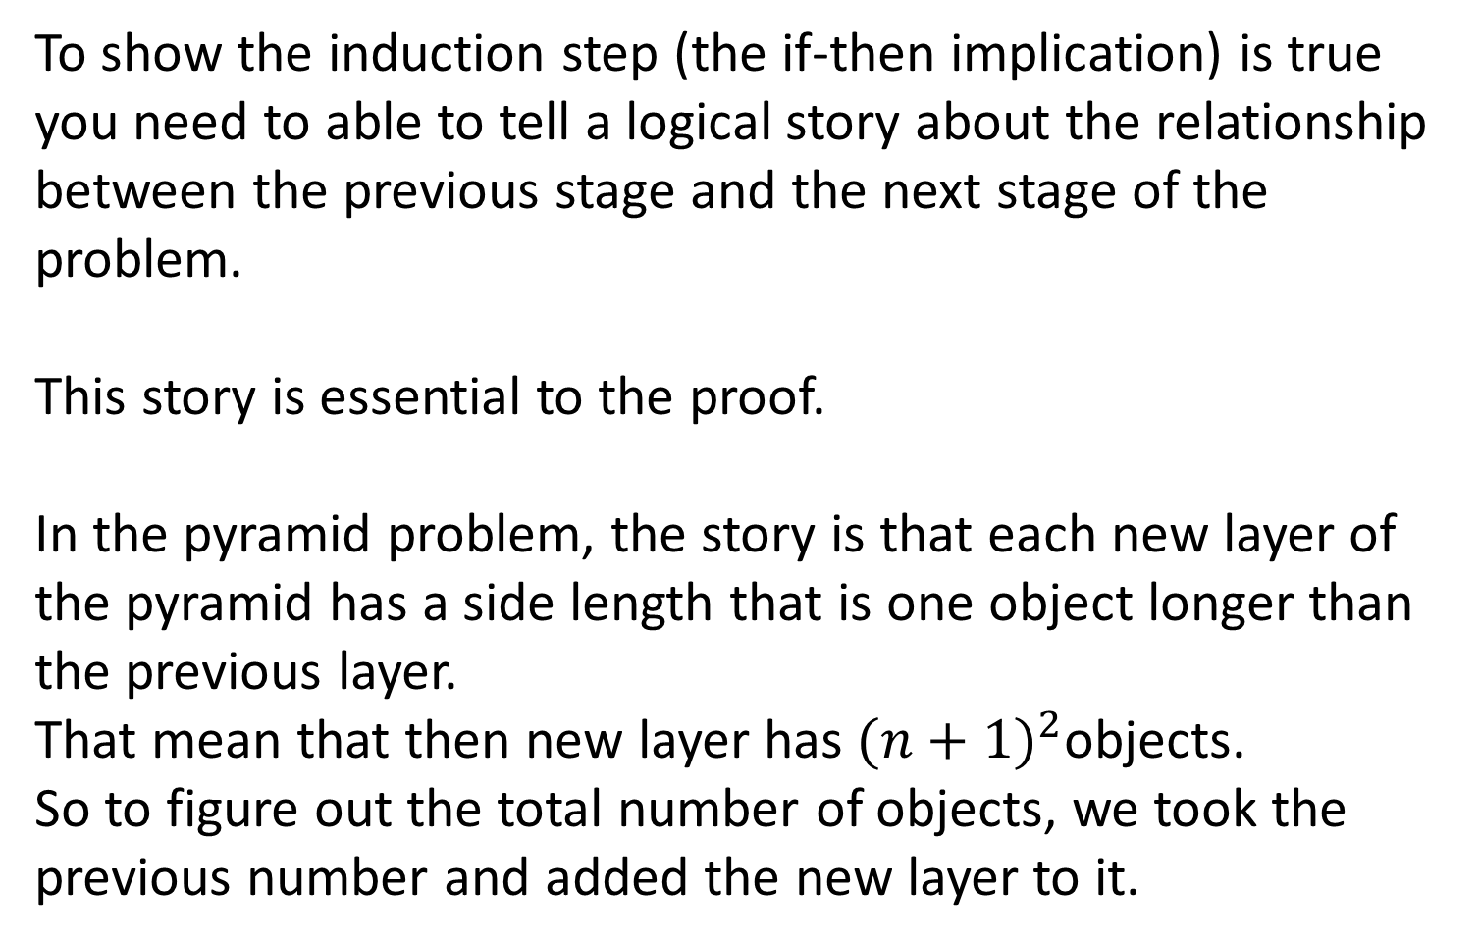
To show the induction step (the if-then implication) is true you need to able to tell a logical story about the relationship between the previous stage and the next stage of the problem.
This story is essential to the proof.
In the pyramid problem, the story is that each new layer of the pyramid has a side length that is one object longer than the previous layer.
That mean that then new layer has ${(n+1)}^{2}$objects.
So to figure out the total number of objects, we took the previous number and added the new layer to it.

Slide 26
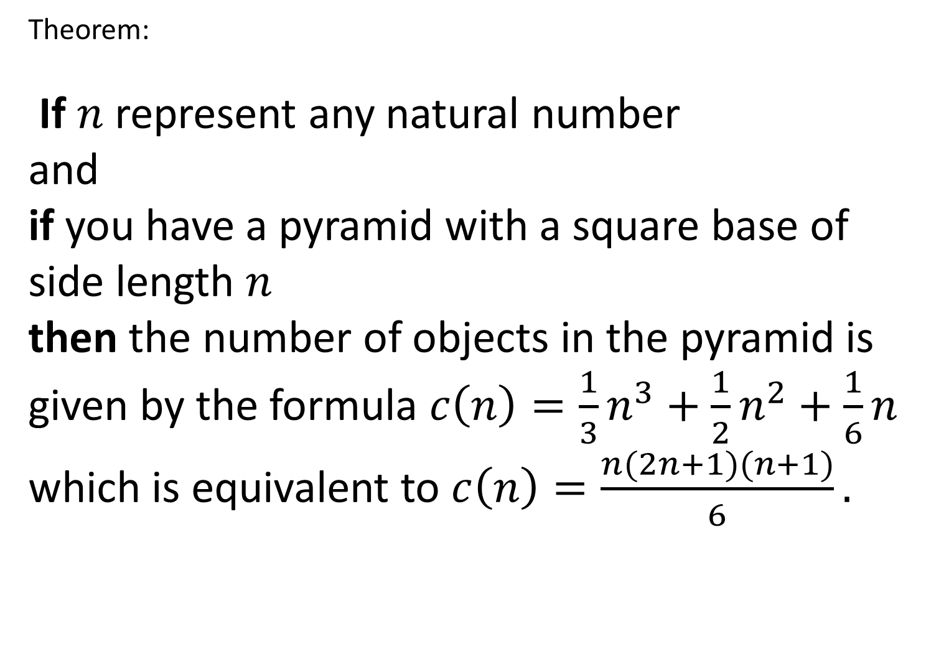
Theorem:
If $n$ represent any natural number
and
if you have a pyramid with a square base of side length $n$
then the number of objects in the pyramid is given by the formula $c\left(n\right)=\frac{1}{3}n^{3}+\frac{1}{2}n^{2}+\frac{1}{6}n$ which is equivalent to $c\left(n\right)=\frac{n(2n+1)(n+1)}{6}.$
I have not shown you how I came up with the formula yet.

Slide 27
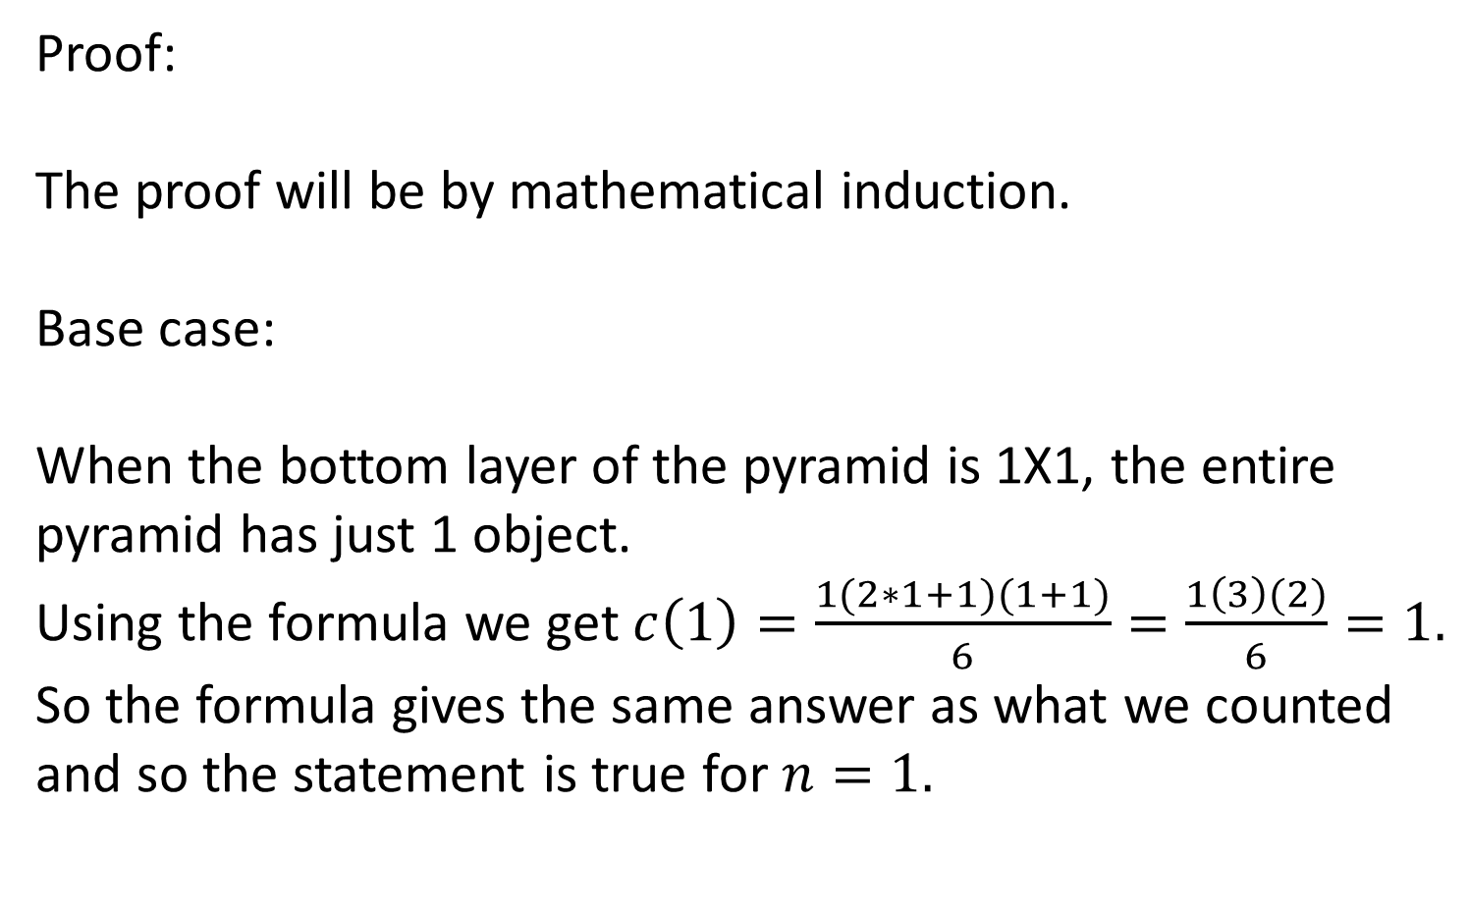
Proof:
The proof will be by mathematical induction.
Base case:
When the bottom layer of the pyramid is 1X1, the entire pyramid has just 1 object.
Using the formula we get $c\left(1\right)=\frac{1(2∗1+1)(1+1)}{6}=\frac{1\left(3\right)(2)}{6}=1.$
So the formula gives the same answer as what we counted and so the statement is true for $n=1.$

Slide 28
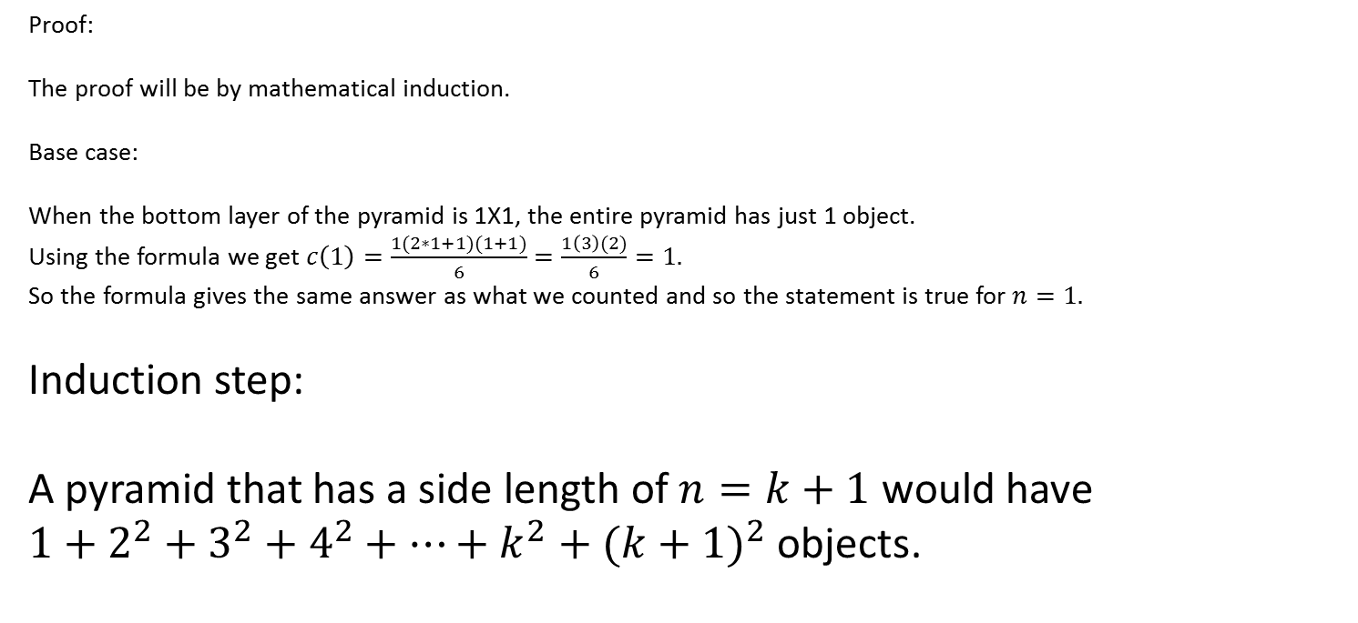
Proof:
The proof will be by mathematical induction.
Base case:
When the bottom layer of the pyramid is 1X1, the entire pyramid has just 1 object.
Using the formula we get $c\left(1\right)=\frac{1(2∗1+1)(1+1)}{6}=\frac{1\left(3\right)(2)}{6}=1.$
So the formula gives the same answer as what we counted and so the statement is true for $n=1.$
Induction step:
A pyramid that has a side length of $n=k+1$ would have
$1+2^{2}+3^{2}+4^{2}+…+k^{2}+({k+1)}^{2}$ objects.

Slide 29
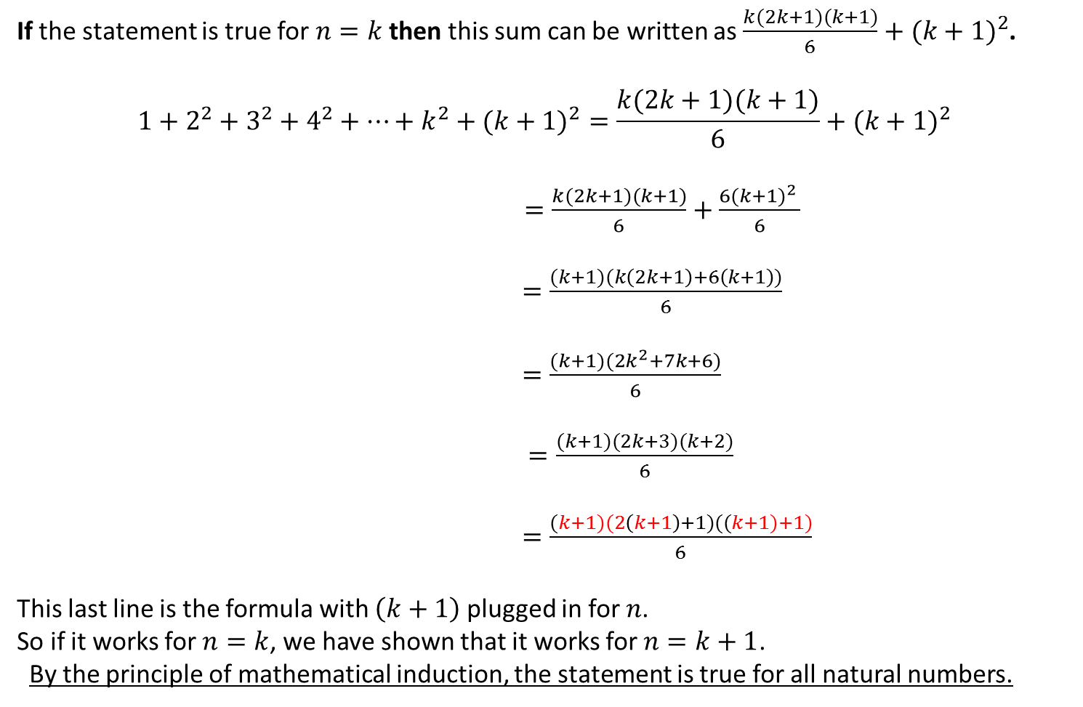
If the statement is true for $n=k$ then this sum can be written as $\frac{k(2k+1)(k+1)}{6}+{(k+1)}^{2}$.
$$1+2^{2}+3^{2}+4^{2}+…+k^{2}+({k+1)}^{2}=\frac{k(2k+1)(k+1)}{6}+{(k+1)}^{2}$$
$=\frac{k(2k+1)(k+1)}{6}+\frac{6{(k+1)}^{2} }{6}$
$=\frac{(k+1)(k\left(2k+1\right)+6\left(k+1\right))}{6}$
$=\frac{(k+1)(2k^{2}+7k+6)}{6}$
$=\frac{(k+1)(2k+3)(k+2)}{6}$
$=\frac{(k+1)(2\left(k+1\right)+1)((k+1)+1)}{6}$
This last line is the formula with $\left(k+1\right)$ plugged in for $n$.
So if it works for $n=k$, we have shown that it works for $n=k+1$.
By the principle of mathematical induction, the statement is true for all natural numbers.

Slide 30
We can sometimes arrive at explicit formulas the data from the table and looking at the finite differences.
Index | Total number of objects | First difference
1 | 1
2 | 5 | 4
3 | 14 | 9
4 | 30 | 16
5 | 55 | 25
6 | 91 | 36
7 | 140 | 49
8 | 204 | 64

Slide 31
The first differences are not constant, so the formula is not a first degree polynomial.
Index | Total number of objects | First difference
1 | 1
2 | 5 | 4
3 | 14 | 9
4 | 30 | 16
5 | 55 | 25
6 | 91 | 36
7 | 140 | 49
8 | 204 | 64

Slide 32
Index | Total number of objects | First difference | Second Difference
1 | 1
2 | 5 | 4
3 | 14 | 9 | 5
4 | 30 | 16 | 7
5 | 55 | 25 | 9
6 | 91 | 36 | 11
7 | 140 | 49 | 13
8 | 204 | 64 | 15
The second differences are not constant, so the formula is not a just a second degree polynomial.

Slide 33
Index | Total number of objects | First difference | Second Difference | Third difference
1 | 1
2 | 5 | 4
3 | 14 | 9 | 5
4 | 30 | 16 | 7 | 2
5 | 55 | 25 | 9 | 2
6 | 91 | 36 | 11 | 2
7 | 140 | 49 | 13 | 2
8 | 204 | 64 | 15 | 2
The third differences are constant, so the formula may be a third degree polynomial.

Slide 34
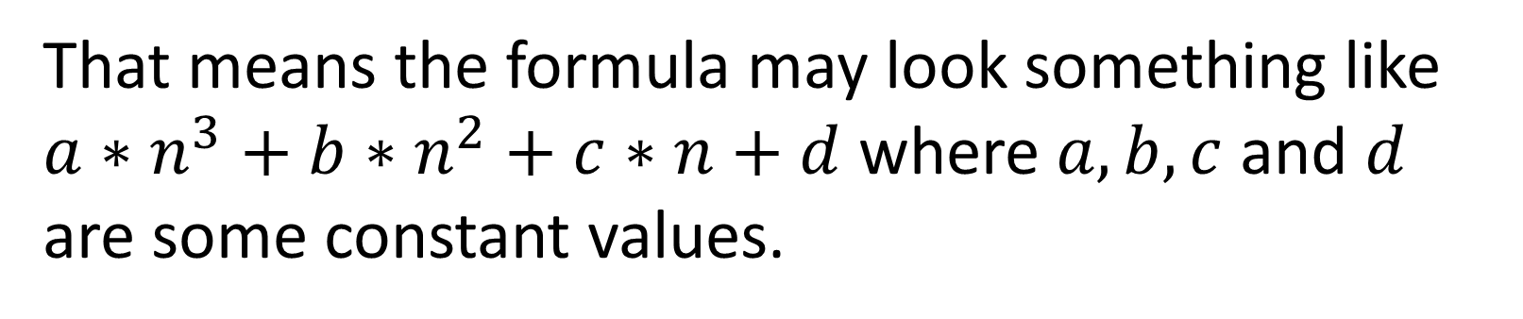
That means the formula may look something like $a∗n^{3}+b∗n^{2}+c∗n+d$ where $a, b,c$ and $d$ are some constant values.
To determine what those constant values are, we will go back to the information we gathered in the table.
It is important to note that if we had not collected the data, or had recorded it incorrectly we would not be able to find the formula. The data should be collected carefully from actual examples.

Slide 35
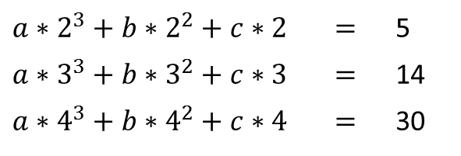
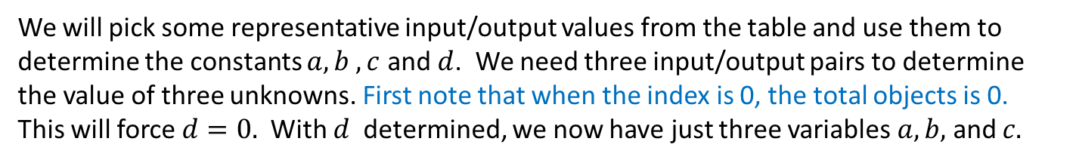
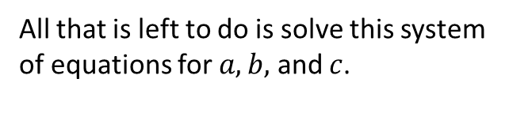
We will pick some representative input/output values from the table and use them to determine the constants $a,b ,c$ and $d$. We need three input/output pairs to determine the value of three unknowns. First note that when the index is 0, the total objects is 0. This will force $d=0.$ With $d$ determined, we now have just three variables $a,b,$ and $c.$
Index | Total number of objects
1 | 1
2 | 5
3 | 14
4 | 30
5 | 55
6 | 91
7 | 140
8 | 204
$a∗2^{3}+b∗2^{2}+c∗2$ | $$=$$ | 5
$a∗3^{3}+b∗3^{2}+c∗3$ | $$=$$ | 14
$a∗4^{3}+b∗4^{2}+c∗4$ | $$=$$ | 30
All that is left to do is solve this system of equations for $a,b,$ and $c$.

Slide 36
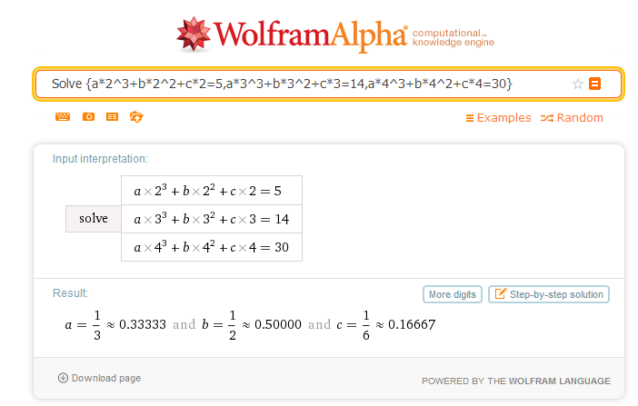

Slide 37

Using the coefficients from solving the system of equations we get
$$c(n)=\frac{1}{3}n^{3}+\frac{1}{2}n^{2}+\frac{1}{6}n$$

Slide 38
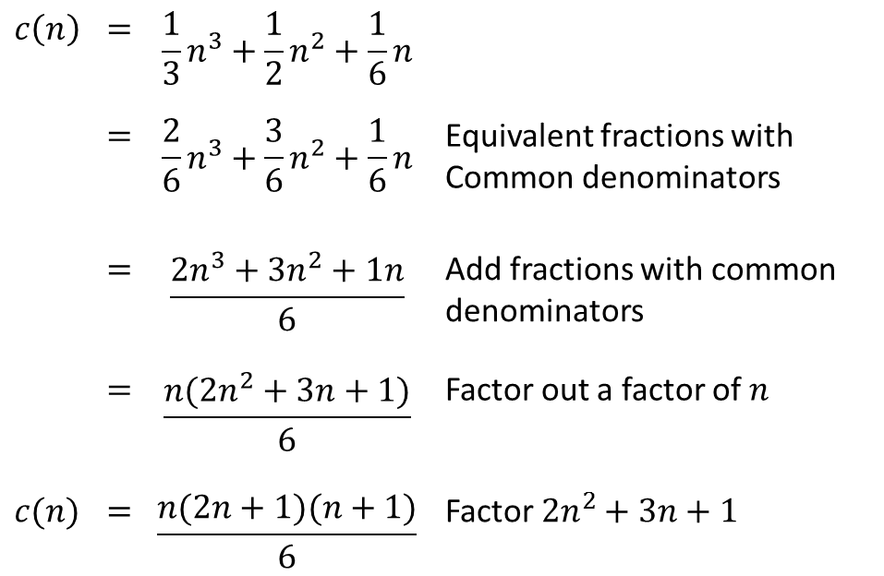
The following algebra just shows that the two formulas are algebraically equivalent. This is not part of the induction proof. It merely shows that the two expressions will give the same values.
$$c\left(n\right)$$ | $$=$$ | $$\frac{1}{3}n^{3}+\frac{1}{2}n^{2}+\frac{1}{6}n$$
 | $$=$$ | $$\frac{2}{6}n^{3}+\frac{3}{6}n^{2}+\frac{1}{6}n$$ | Equivalent fractions with Common denominators
 | $$=$$ | $$\frac{2n^{3}+3n^{2}+1n}{6}$$ | Add fractions with common denominators
 | $$=$$ | $$\frac{n(2n^{2}+3n+1)}{6}$$ | Factor out a factor of $n$
$$c(n)$$ | $$=$$ | $$\frac{n(2n+1)(n+1)}{6}$$ | Factor $2n^{2}+3n+1$

